Slide 1
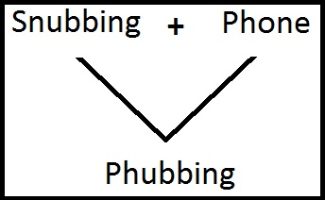
One definition of phubbing is “the activity of being impolite in a social situation by looking at your phone instead of paying attention to the person you are with.”

Slide 2
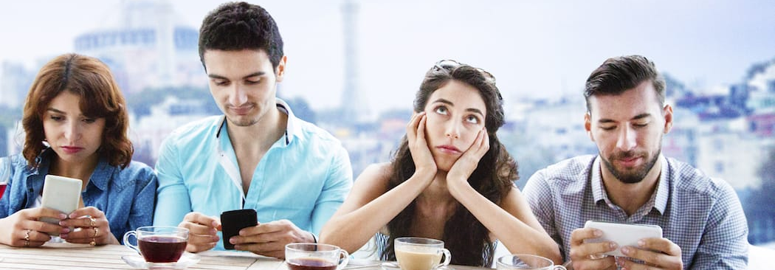
A study in 2016 found that texting during a conversation made the talk less satisfying for the people having it, compared to people who interacted without phones.

Slide 3
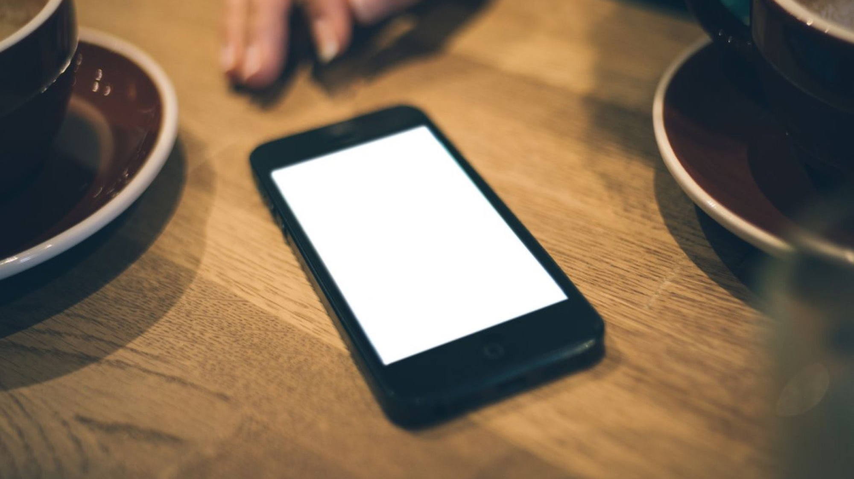
A 2012 study even found that the mere presence of a cell phone during a conversation — even if no one was using it — was enough to make people feel less connected to each other.

Slide 4
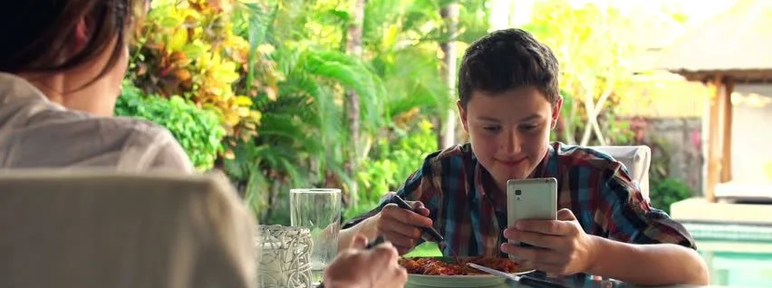
One study found that people who used their phones while eating with friends or family said they enjoyed their meal less and felt more distracted and less engaged than those who didn’t use tech at the table.

